Slide 1
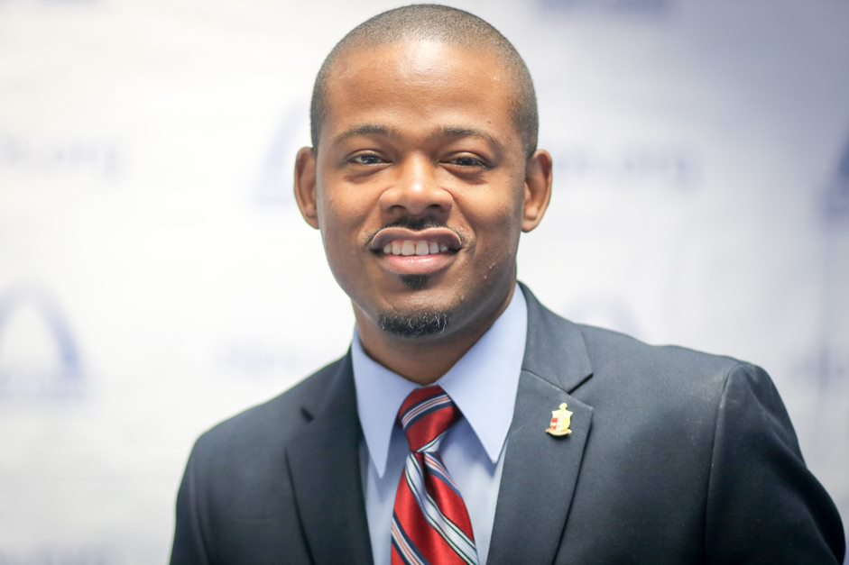


Meet the principal
Jim Triplett, Principal

Slide 2
Welcome Scholars
2022-2023

Slide 3
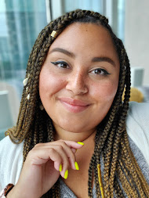
All about Ms. Eason

Slide 4
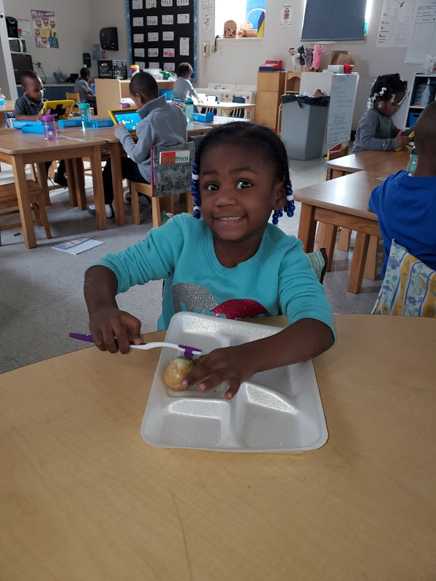
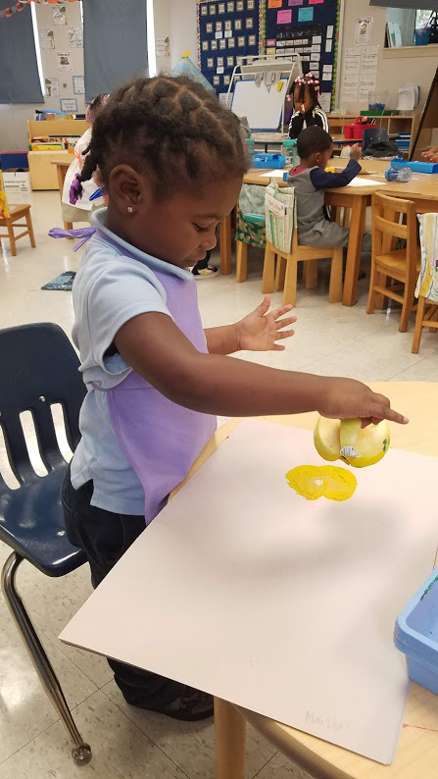
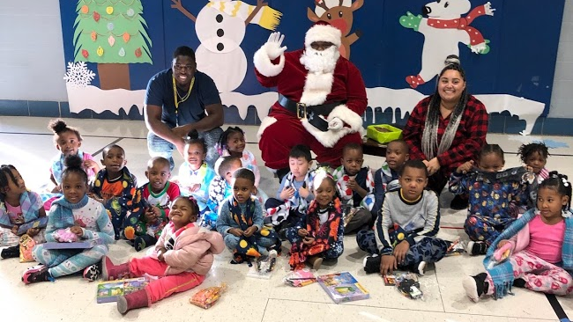
experience
This is my 7th year teaching at Froebel!!
I have degrees in early childhood education and elementary
Education from Southeast Missouri University.

Slide 5
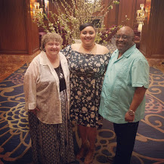
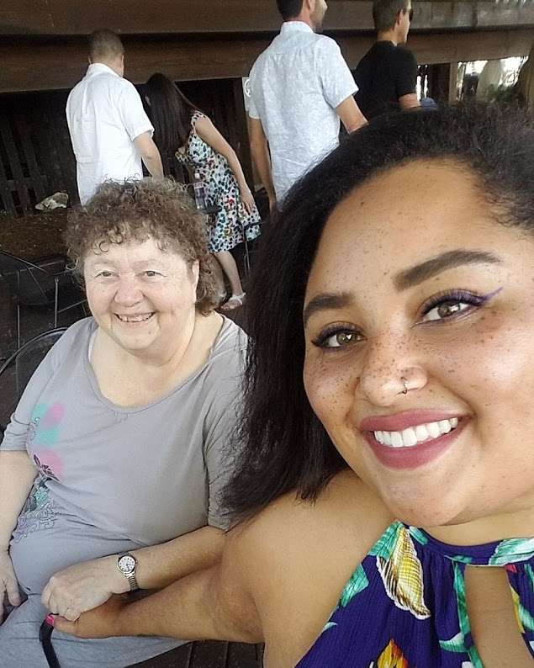
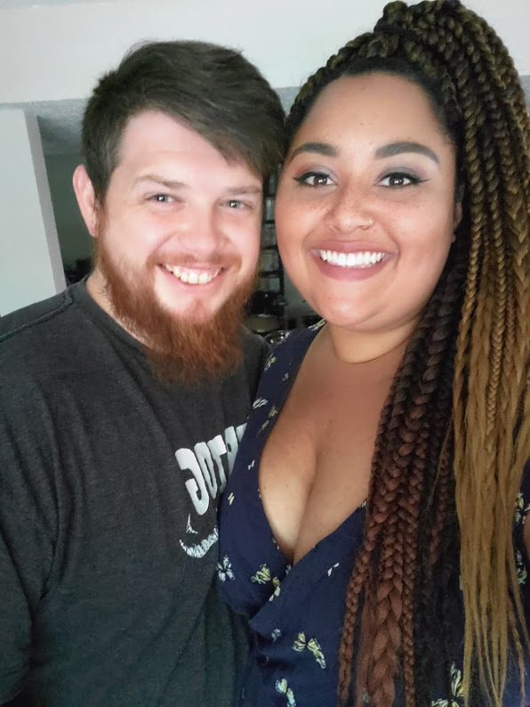
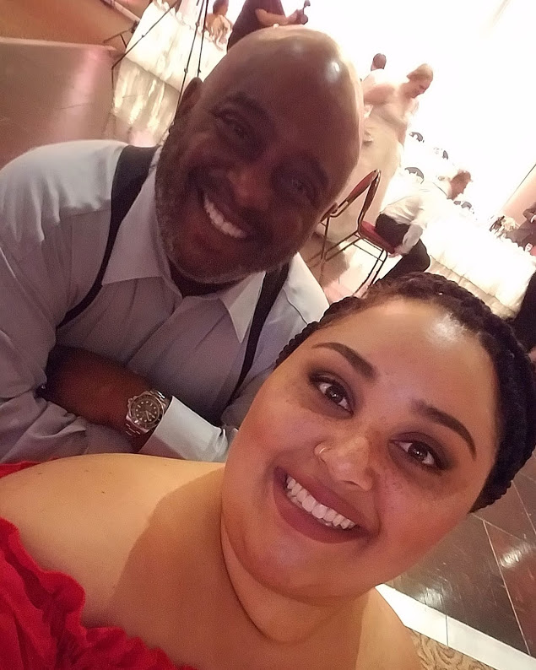
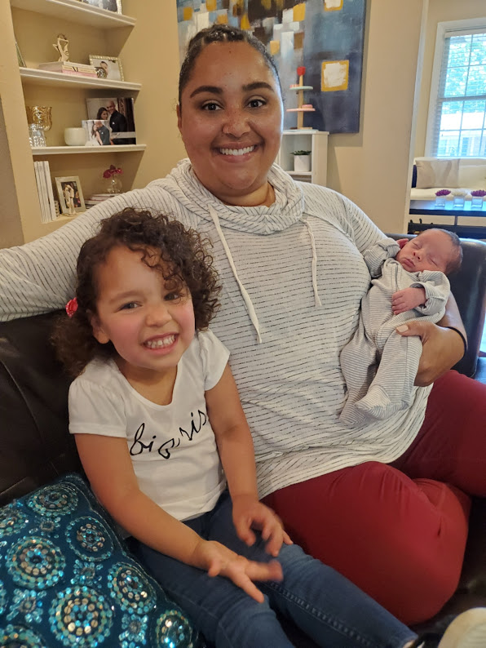
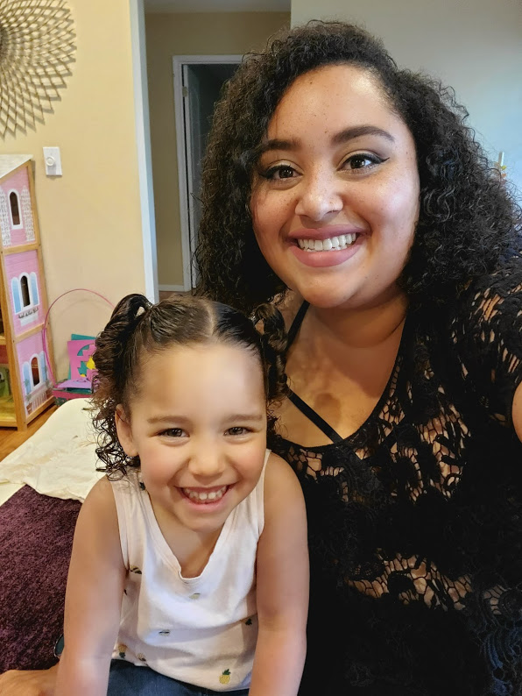
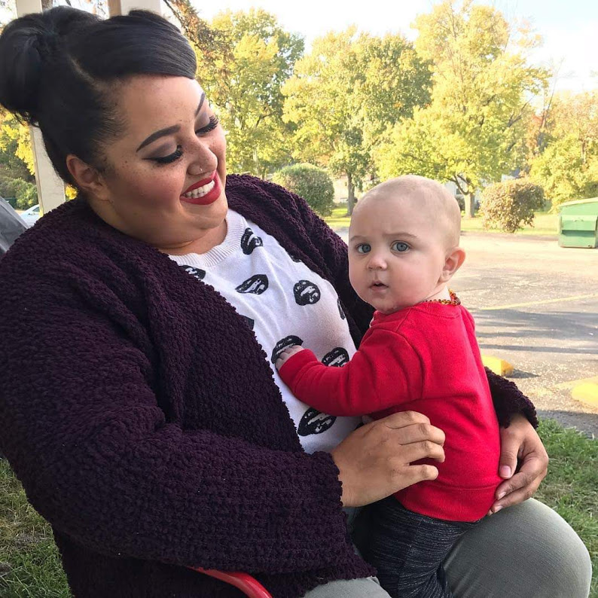
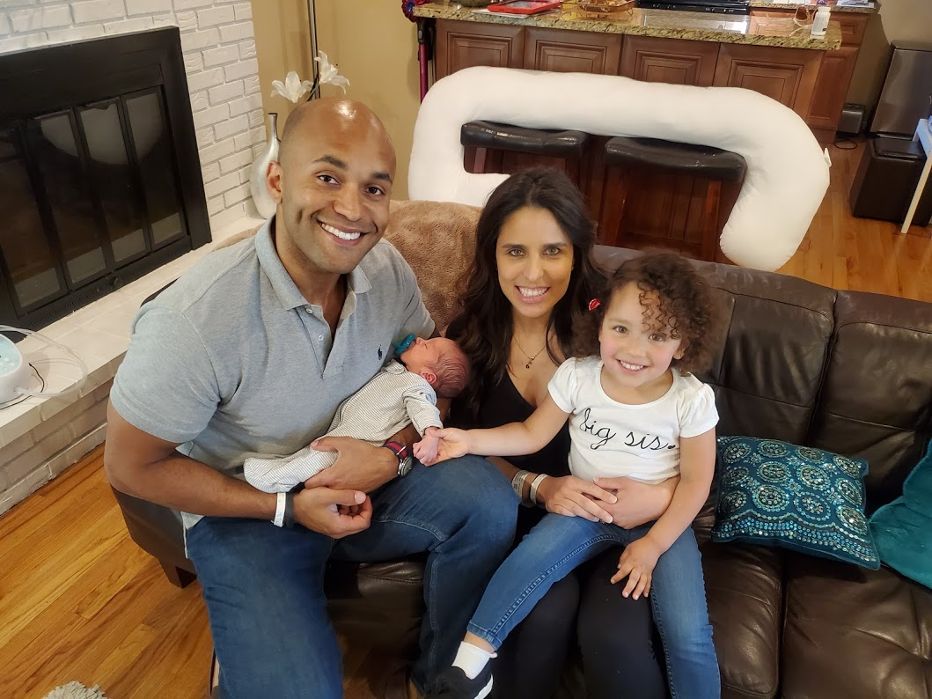
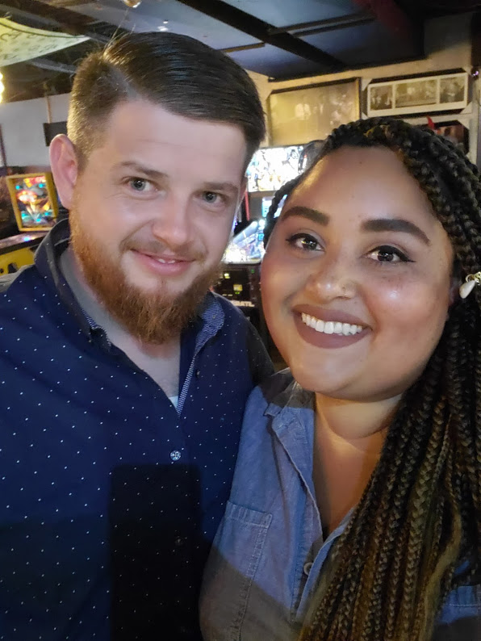
Family
I come from a very close family.
My parents have been happily married for over 30 years.
I have one brother and a niece and nephew

Slide 6
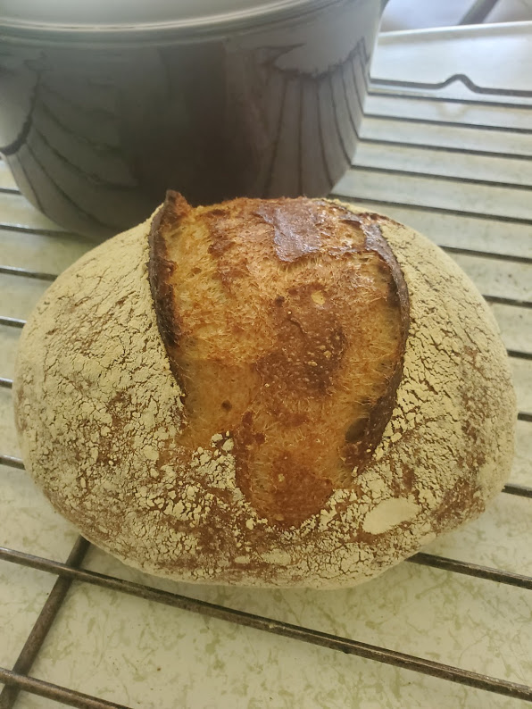
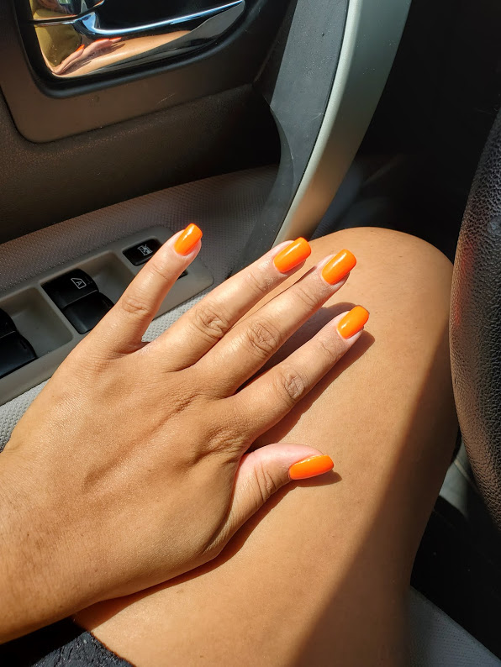
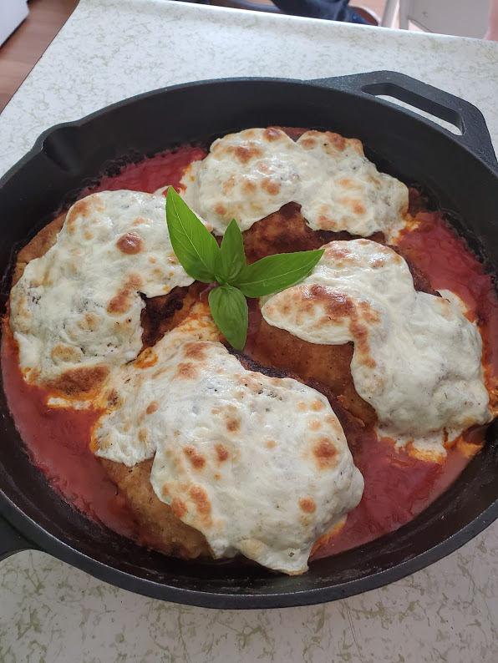
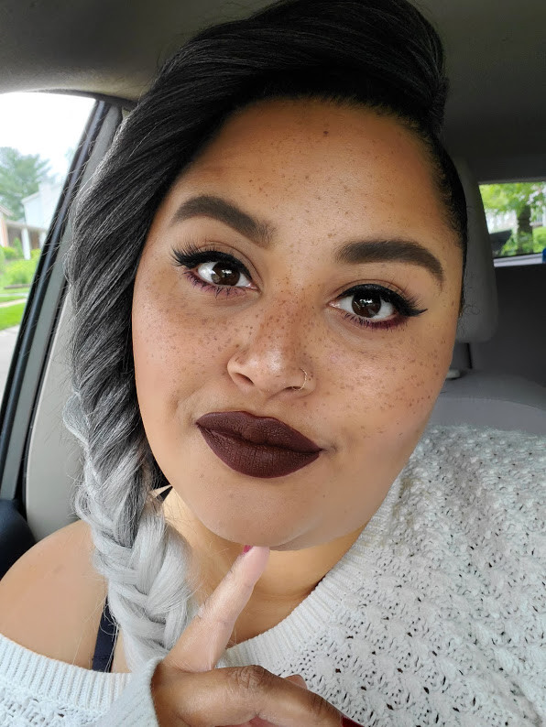
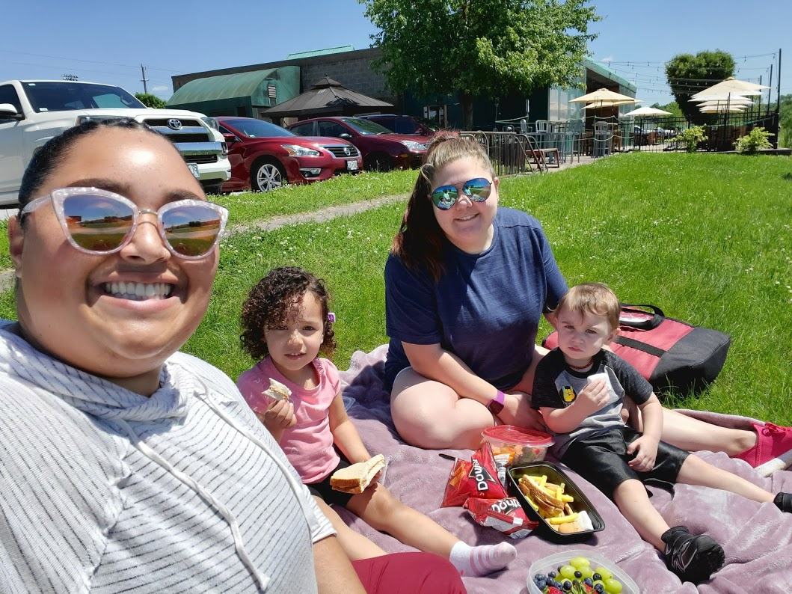
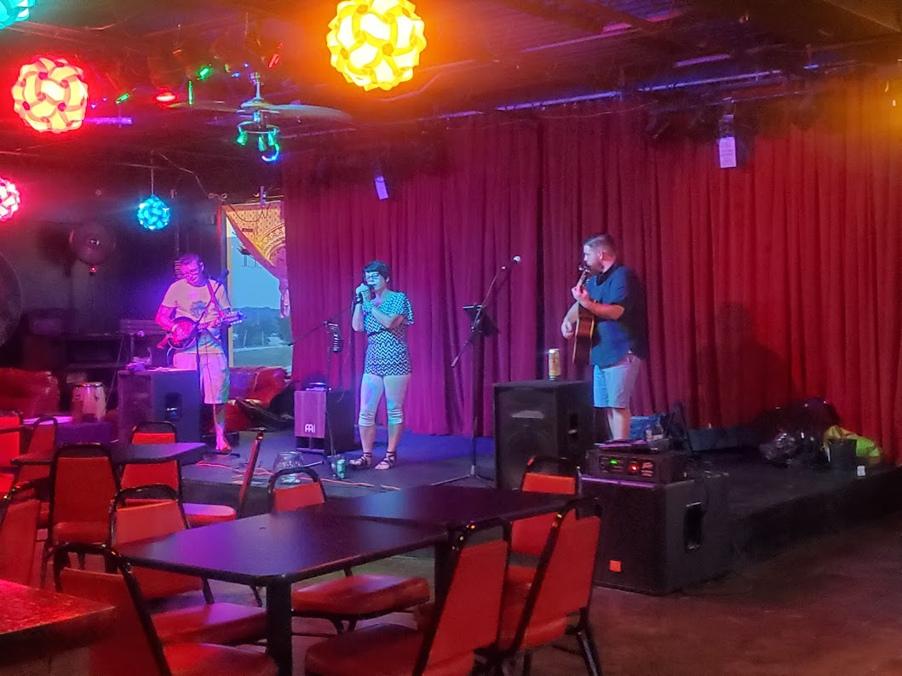
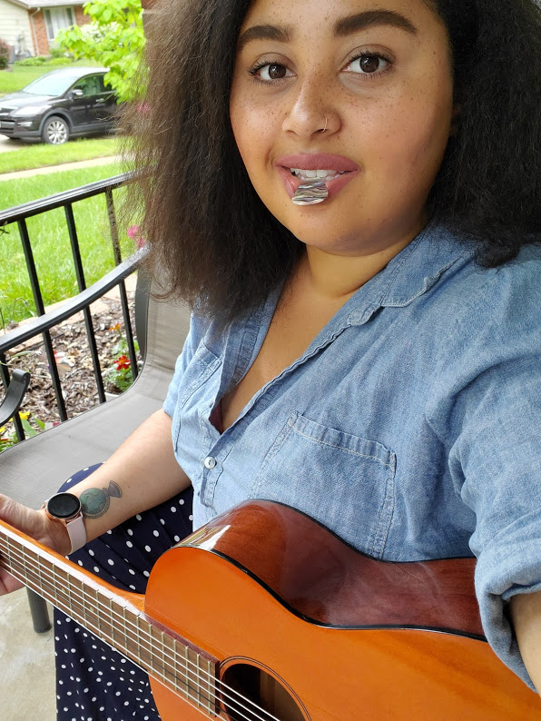
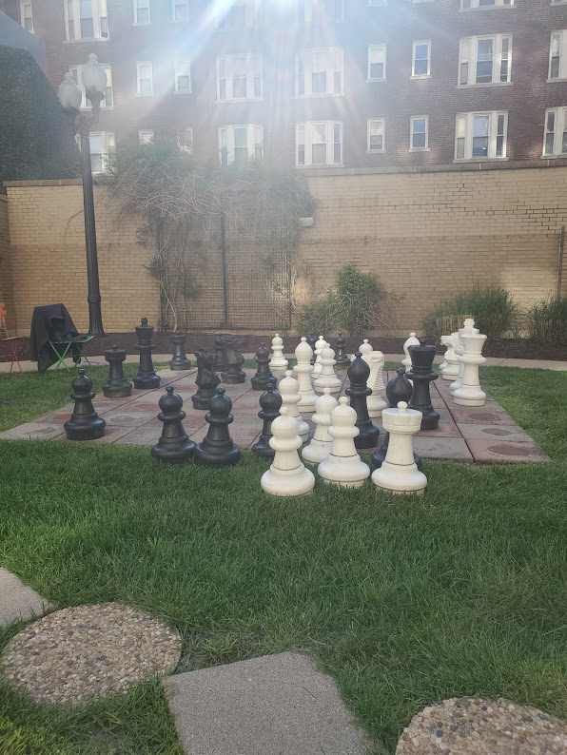
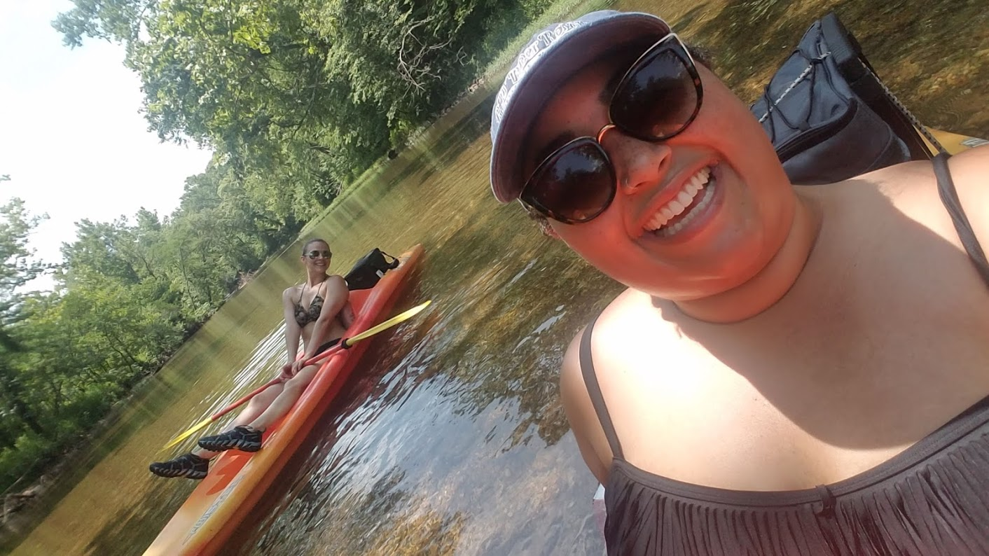
Hobbies
Baking
Getting my nails done
Cooking
Doing my hair and makeup
Picnics with friends
Learning to play the guitar
and ukulele
Listening to live music
Learning to play chess
Kayaking

Slide 7
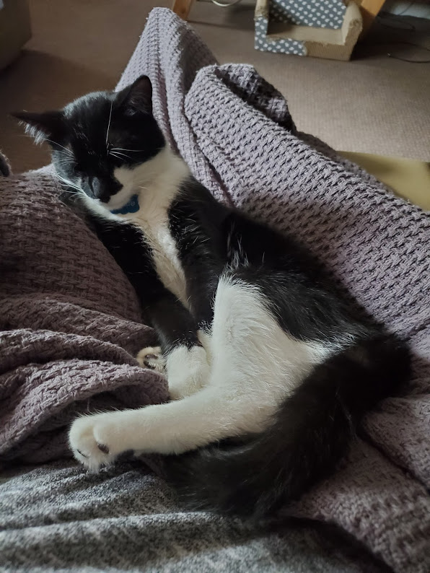
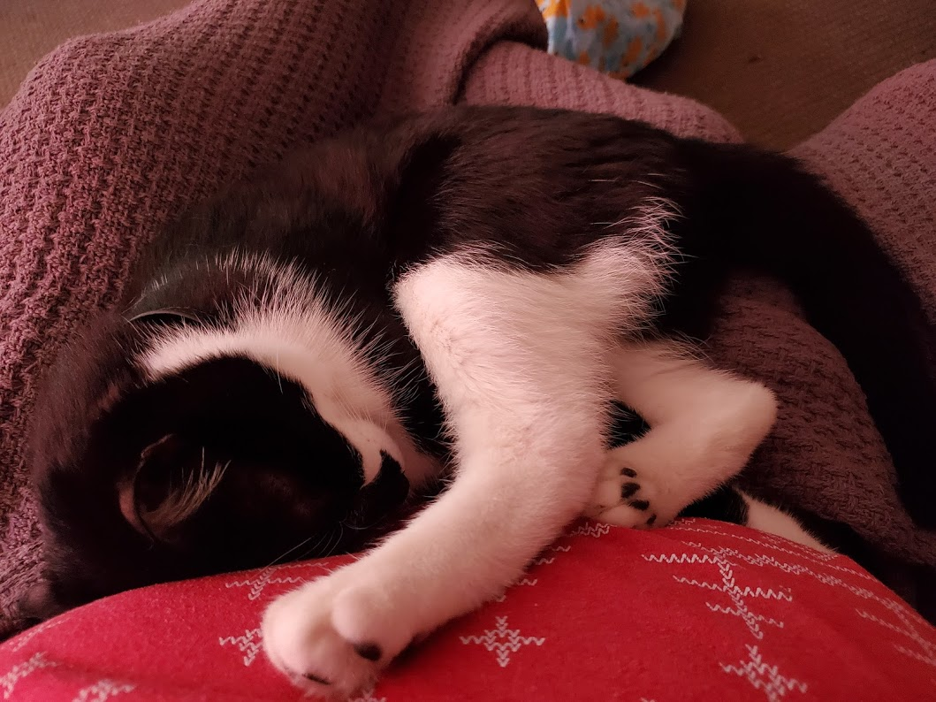
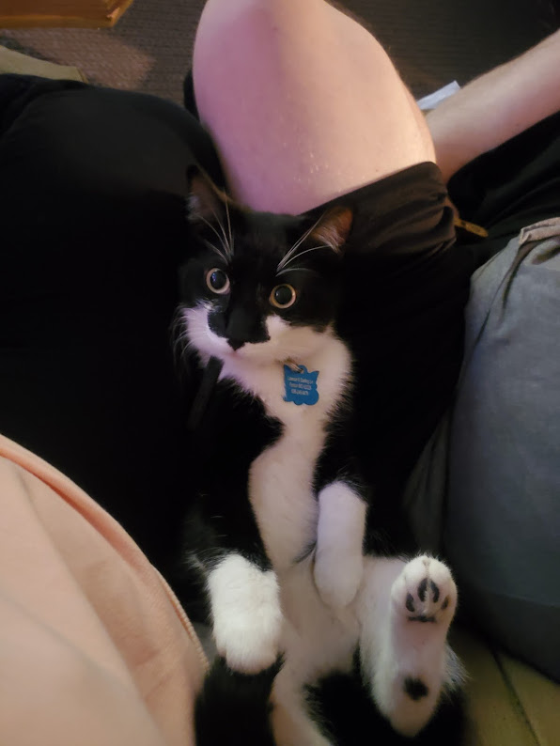
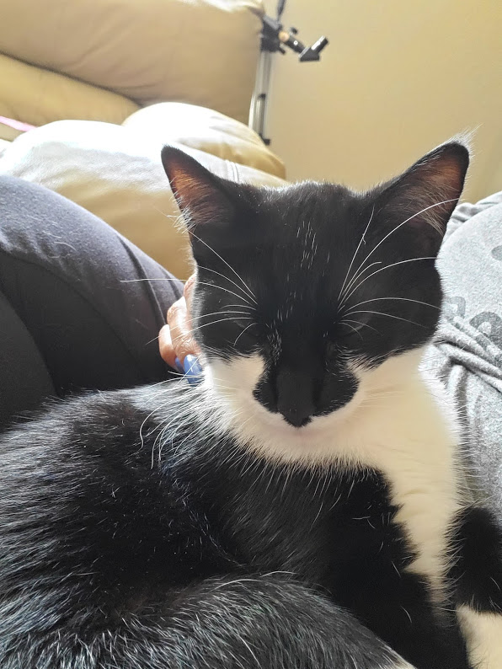
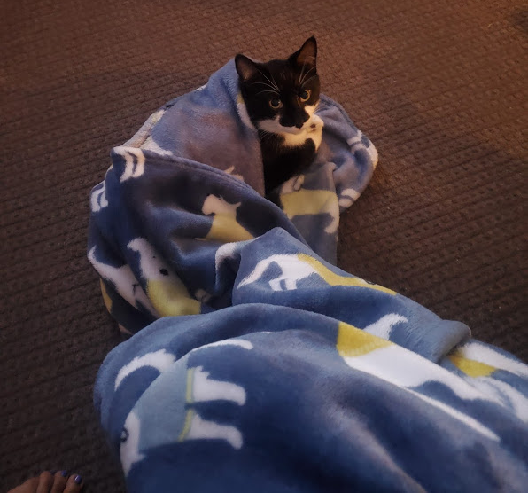
Pets
This is my cat Dude!! I love his snuggles!!

Slide 8
Daily schedule
Arrival 9:00am through door 5
Breakfast 9:00am-9:20am
Specials 9:30-10:20
Lunch 11:30-12:00
Recess12:00-12:15
Nap

Slide 9
uniforms
The Froebel Literacy Academy school uniform is khaki, black, or navy blue pants, skirt, shorts, or jumpers, with a white, navy, or light blue-collared shirt or polo shirt.
Uniforms are to be worn daily. Incentives and rewards will be given to students who consistently come dressed appropriately and ready to learn.

Slide 10
Absences and tardiness
One of the key factors in the success of any students is attendance. Coming to school daily and beginning on time is required.
If your child is going to be absent you will need to call the school and notify them of any and all absences. When your child returns to school bring any medical documentation that may apply. Please also let me know if your child is going to be tardy or absent so I can properly plan for the day.
Froebel Literacy Academy: (314) 771- 3533
Ms. Eason: (224) 993-9826
Breakfast begins at 9:00am daily. Your child is considered tardy at 9:20am and will need to check into the front office.

Slide 11
Important people
Froebel Literacy Academy Administrative Staff
Mr. Triplett School Principal
Ms. As-Siyeed School Secretary
Mr. Smith Family and Community Specialist
Ms. Howard School Nurse
Mr. Cato School Counselor
Mrs. Buwalda School Social Worker
Mrs. Thomas School Academic Instructional Coach
Pre-School Staff
Ms. Jennifer Eason Room 004
Mrs. Christina Nolan Room 110

Slide 12
homework
Homework is an important part of our daily learning. It provides students with the much needed opportunity to review and practice important skills they’re learning in class. It also helps to set good habits and routines for continued education.
Student’s will receive a monthly homework packet. Students will work on one page of their homework packet (with help from an adult) each night. The homework packet with come to school daily and be checked for completion. I will collect the homework packets at the end of each month. Rewards for completing and returning homework packets will be a monthly class party.

Slide 13
supplies
DAILY
Backpack large enough to fit a folder
Fully charged iPad
Blue folder
School uniform
Healthy snack
WEEKLY
Small blanket for rest time
Sent home on Fridays to be washed
CLASSROOM WISH LIST
Tissues
Clorox Disinfecting Wipes
Hand Sanitizer
EXTRA CLOTHING
Socks
Shirt
Underwear
Pants

Slide 14
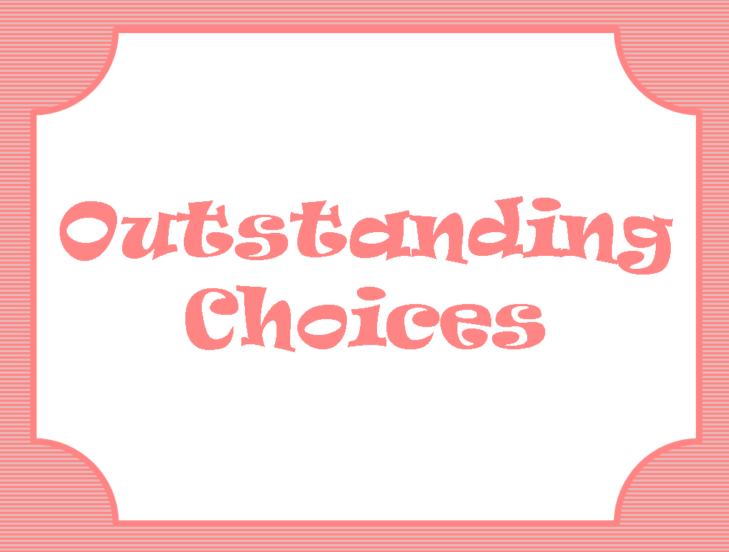
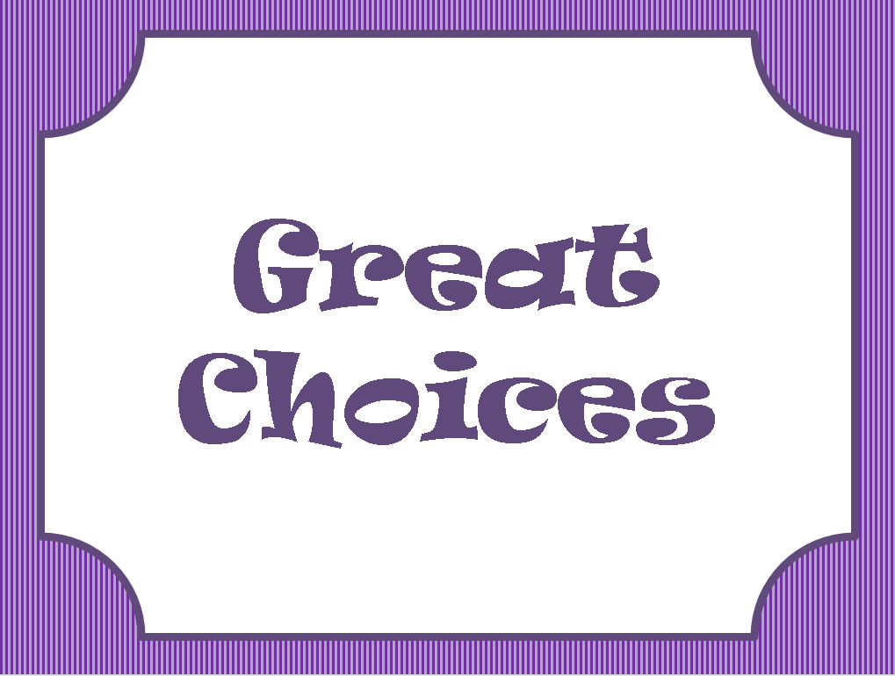
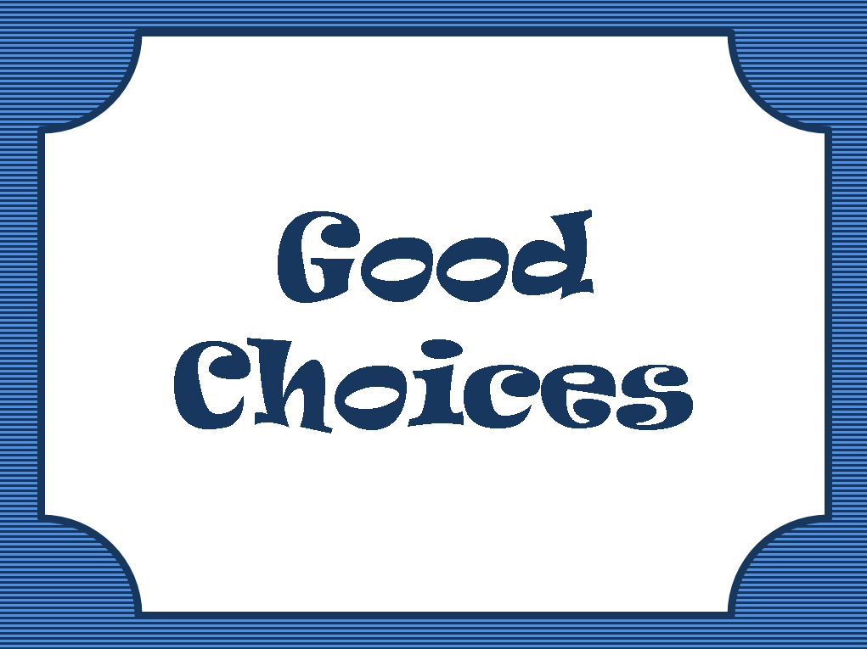
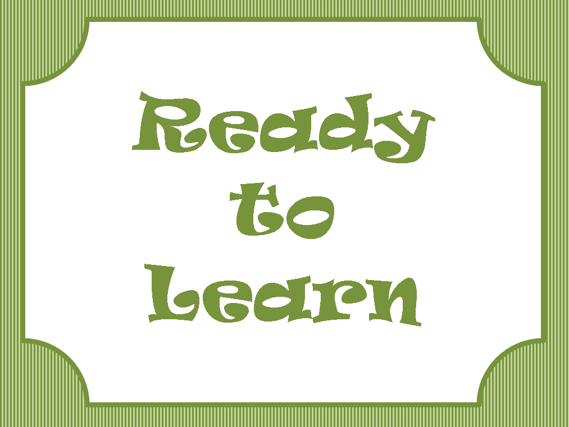
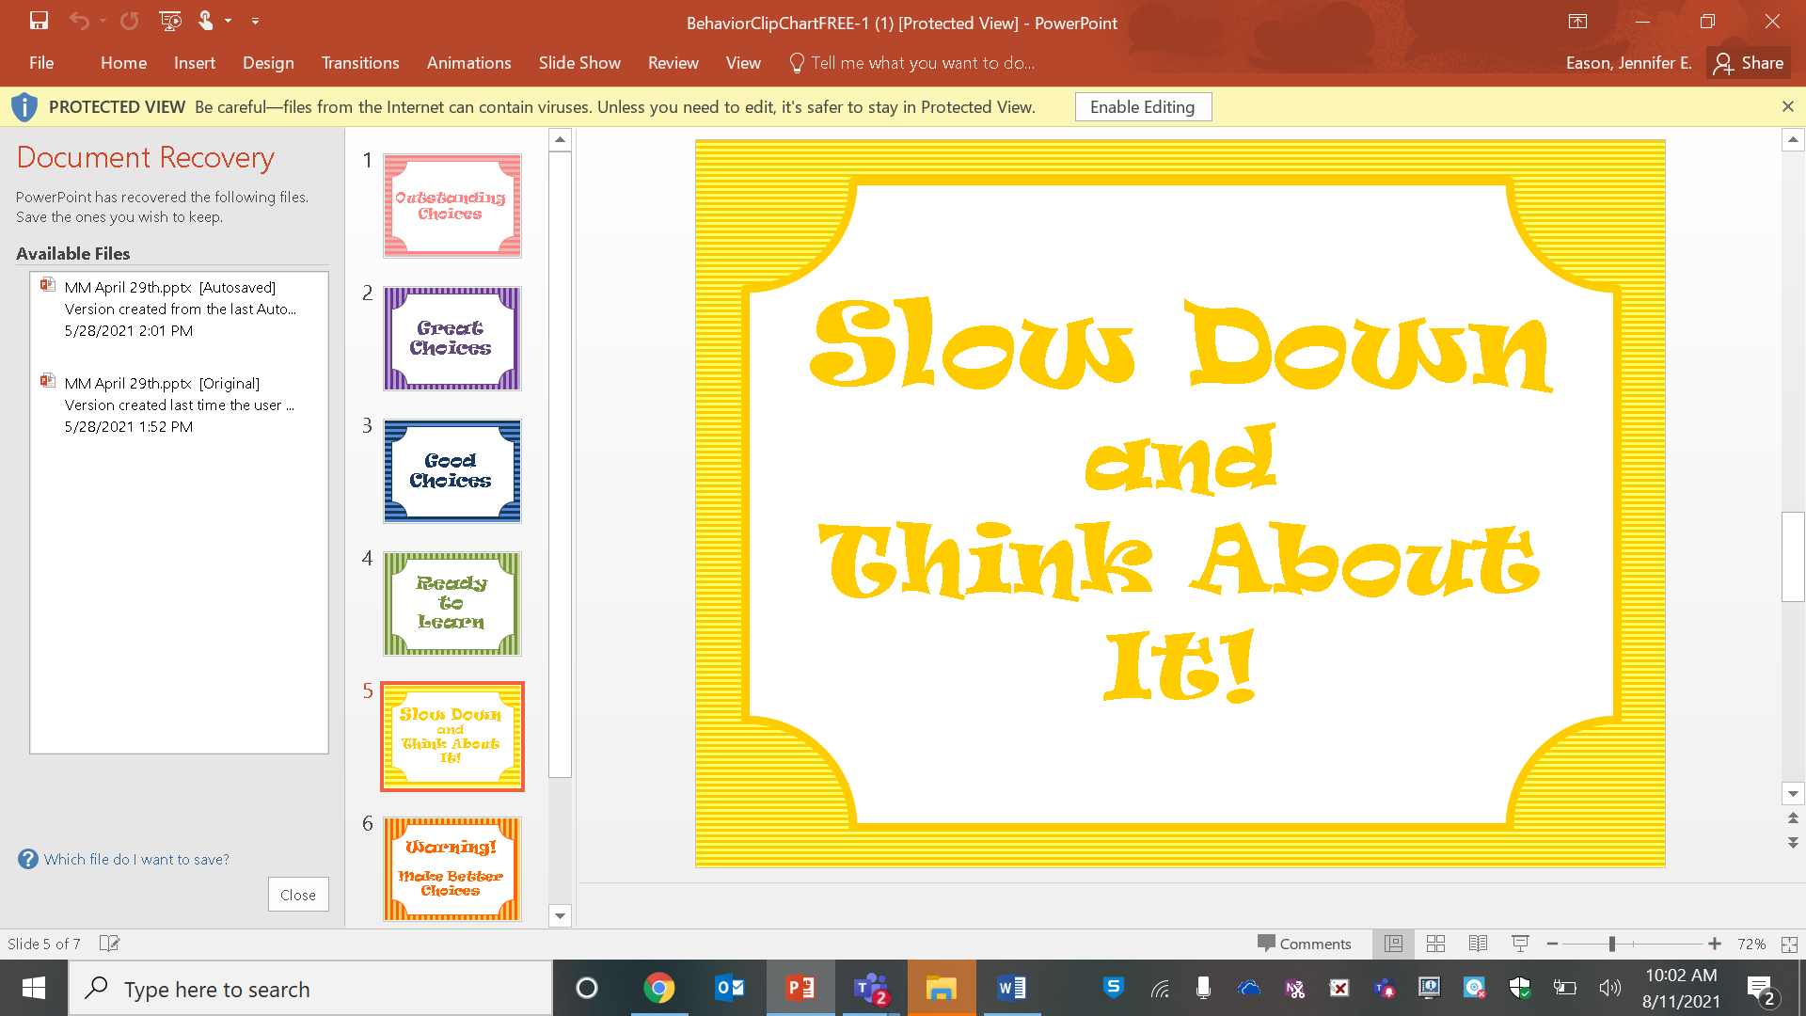
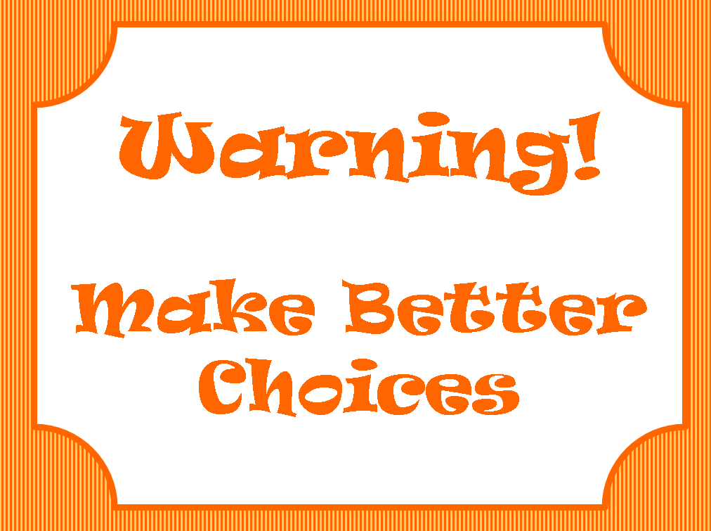
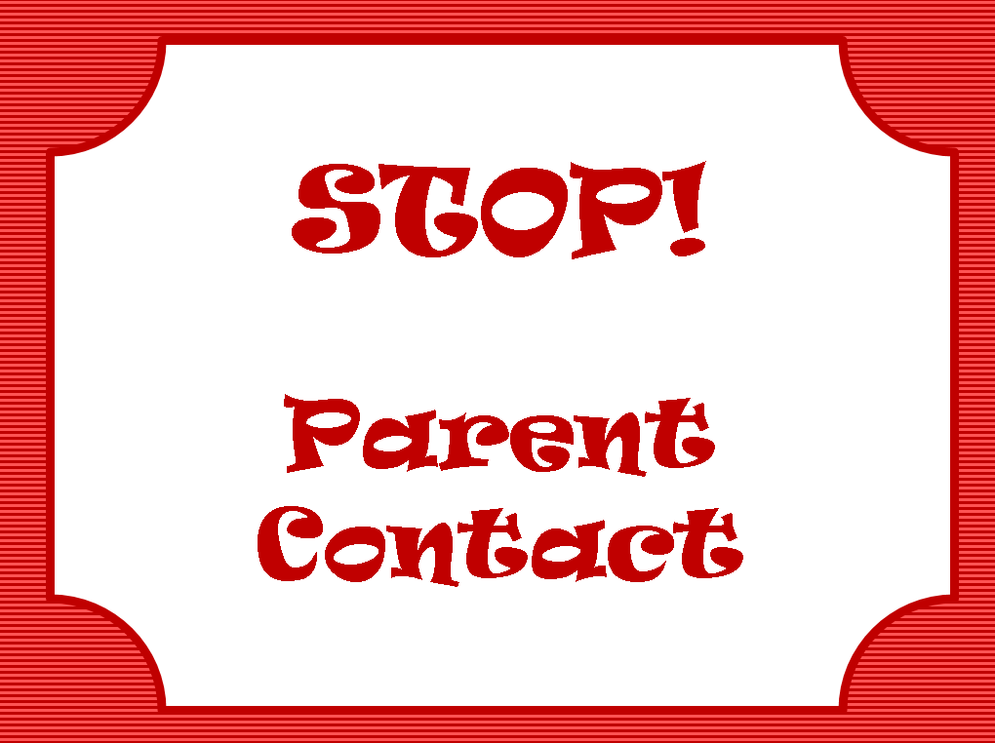
Behavior management
In our Pre-Kindergarten classroom we employ a variety of strategies and techniques to ensure all the students in the class are safe, on task, and consistently learning throughout the day.
BEHAVIOR CLIP CHART
All students in our class begin on green ‘Ready to Learn’. Throughout the day students will move their clips up and down the behavior chart. The students will move their clips according to whether they meet classroom expectations or not. At the end of the day the students will record their behavior on their Monthly Behavior Calendar. Students who receive greens or above throughout the week will have access out Weekly Prize Box. Students who remain on green or above throughout the whole month will have access to the Monthly Prize Box.

Slide 15
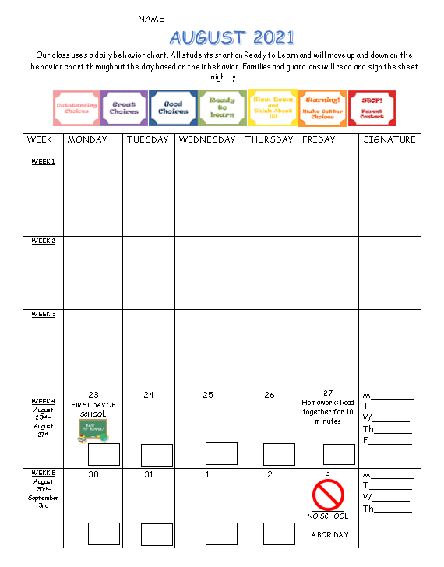
MONTHLY BEHAVIOR CALENDAR (MBC)
All students will receive a (MBC) at the beginning of the month. The calendar will have announcements, important dates, homework information, and behavior information. The MBC will go home each night in the students blue folder and come back to school the following day. Each night a parent or guardian will read and initial the MBC in the space provided to the right of the calendar.

Slide 16
Class dojo
Our class uses an app called Class Dojo for positive reinforcement of appropriate behaviors at school. Each time students are meeting classroom expectation they will receive points on Class Dojo. Parents can access Class Dojo account to see how their child is doing throughout the day, as well as communicate with me. Points are rewarded for…
Being on time
Coming to school prepared
Wearing your uniform
Being on task
Being respectful
Being responsible
Being safe
Wearing a mask properly
Being a good friend
Having a listening body
Being a leader

Slide 17
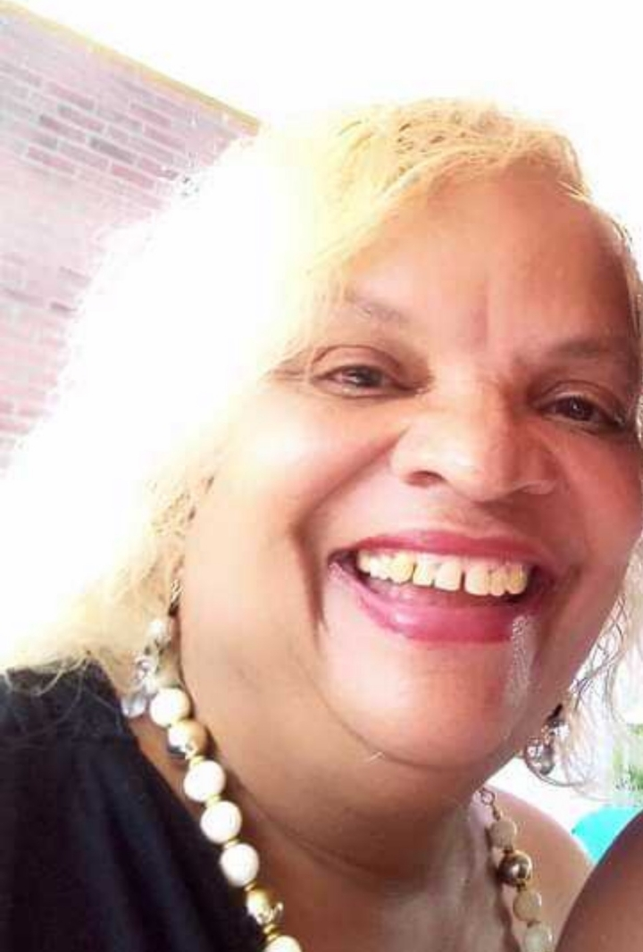
Hi My Name is Valerie White And I am The Library Aid Welcome Froebel Eagles

Slide 18
Welcome Froebel Eagles
My name is Jenny Buwalda and I am the School Social Worker at Froebel Literacy Academy. I am in the office on Mondays, Thursdays and Fridays and will always be available through email. If you are in need of any additional resources, please contact me. I look forward to meeting all of you during the upcoming 2021-2022 school year.
Jenny Buwalda
Jennifer.Buwalda@slps.org
314-771-3533

Slide 19
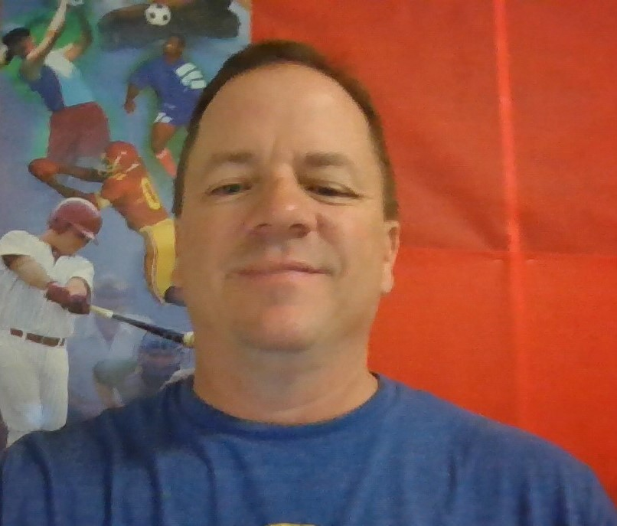
Physical Education
Mr. Nusser
Bachelor of Science in Physical Education from Missouri State University.
This will be my 24th year at Froebel.
Grew up in Toledo, Ohio.
Married with 4 kids ages 18, 17, 15 & 13.
Pets; Fish.

Slide 20
My name is Patricia Costello, I want to Welcome our families to the 2021 – 2022 school year here at Froebel Literacy Academy. I am looking forward to serving our families, sharing resourceful information and encouraging your parental involvement at our academy. I can be reached by phone: (314) 771-3533 or email: Patricia.Costello@slps.org
“In order to understand our present and ensure our future, we must know our past.”
Family and Community Specialist

Slide 21

Microsoft Teams
We will be using Teams in the event in person learning can not take place.
Please contact me if you have a hard time logging into teams.

Slide 22
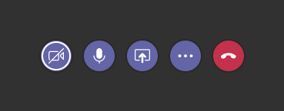
Microsoft teams
This is the camera button. When you see a line through the camera, your video is off. When you click on the camera button, the line will disappear, and your camera will be on.
This is the sound button. It is a picture of a microphone. When you click on this button, a line will appear across the microphone. When you see the line through it, you are on mute, and no one can hear you.
When you click on this icon again, the line will disappear, and your microphone will be on, allowing everyone to hear you.

Slide 23
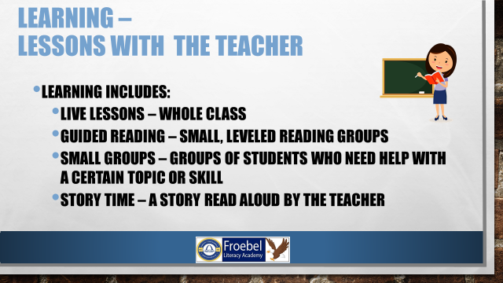

Slide 24
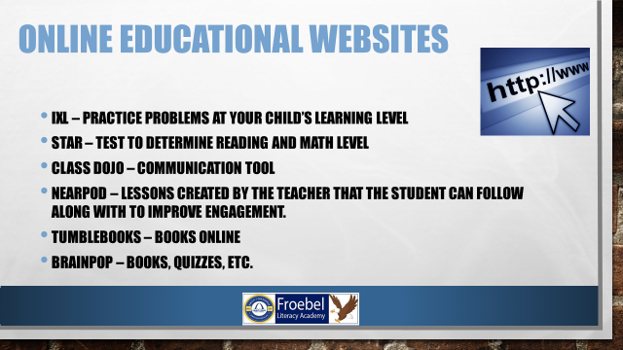

Slide 25
Contact information
Class dojo: https://www.classdojo.com/invite/?c=C9B93KJ
Email: Jennifer.eason@slps.org
Phone: (224) 993-9826

